Slide 1


GUIDOTRONIC BOT INTEGRATE WITH LIDAR AND AI VOICE ASSISTANCE
GUIDED BY,
MR. BIJU GEORGE G
AP/ECE
SUBMITTED BY,
ASWIN N [963520106014]
JOHN TENI JIO F [963520106026]
PRAGNESH M [963520106034]
ECE - 2024
BATCH: 11

Slide 2
ABSTRACT
In this project, we explore the integration of AI Voice Assistance with Guidotronic Bot, facilitating natural language interaction.
Guidotronic Bot, known for its versatility in task execution, is seamlessly combined with LiDAR technology for precise environmental mapping.
Advanced algorithms ensure efficient communication between components, resulting in improved navigation accuracy and enhanced user interaction capabilities.

Slide 3
OBJECTIVE
To develop a user-friendly, Autonomous Robot that utilizes LiDAR for safe navigation and AI Voice Assistance for intuitive interaction, enabling it to effectively guide users in complex or dynamic environments.

Slide 4
INTRODUCTION
The landscape of automation is undergoing a revolution.
We are witnessing a shift from simple, pre-programmed robots to intelligent machines capable of navigating complex environments, understanding human commands, and adapting to changing situations.
This advancement hinges on the powerful synergy between three key technologies:
LiDAR (Light Detection and Ranging)
Artificial Intelligence (AI)
Voice Assistance

Slide 5
PROBLEM STATEMENT
Getting lost: You don't know where you're going in a new place.
Language barrier: You can't talk to people for help.
Confusing directions: Even if someone tells you where to go, you might not understand.
Easy to get turned around: It's hard to find your way back if you get lost.
Missing out on info: You might miss cool things because you don't know what's around.

Slide 6
NEED OF GUIDOTRONIC BOT
Guidotronic bot addresses the need for accurate navigation in complex environments.
It fulfills the need for efficient obstacle detection and avoidance to ensure safe movement.
The integration enables seamless communication with users through natural language commands, overcoming language barriers.
Guidotronic bot enhances user experience by providing real-time guidance and information in unfamiliar places.

Slide 7
LITERATURE SURVEY
S.NO | Name of Authors | Year | Title of the paper | Concept Used | Merits | Demerits
1. | C.Li, X.Li, X.Wang, and Z.Duan | 2022 | Human-Robot Interaction with Natural Language for Mobile Robots in Smart Homes | This paper investigates human-robot interaction using natural language for mobile robots in smart homes. | The paper introduces a seamless and intuitive method for human-robot interaction in smart homes, leveraging natural language commands to enhance user experience and control over mobile robots. | However, challenges related to natural language processing accuracy and understanding nuances in human language may affect the system's reliability and user satisfaction.

Slide 8
LITERATURE SURVEY (CONT)
S.NO | Name of Authors | Year | Title of the paper | Concept Used | Merits | Demerits
2. | W.Wang, D.Xu, Y.Cao, and Q.Huang | 2020 | SLAM-based Indoor Robot Navigation with Voice Control | This research focuses on integrating Simultaneous Localization and Mapping (SLAM) with voice control for robot navigation. | The paper offers a user-friendly approach to indoor robot navigation through SLAM (Simultaneous Localization and Mapping) with intuitive voice control, enhancing accessibility and ease of interaction. | However, reliance on voice control may introduce challenges in noisy environments or for users with speech impairments, potentially limiting the system's effectiveness in certain scenarios.

Slide 9
LITERATURE SURVEY (CONT)
S.NO | Name of Authors | Year | Title of the paper | Concept Used | Merits | Demerits
3. | M.Bennewitz, S.Behnke, S.Balakirsky, and A.Burgard | 2020 | Navigating Public Places with a Social Robot | This research delves into using robots with LiDAR and voice interaction for navigation in public spaces. | The paper proposes a novel solution to enhance accessibility and support in public spaces through the use of social robots. | However, it may not adequately address potential social and ethical concerns surrounding the widespread deployment of robotic systems in public settings.

Slide 10
LITERATURE SURVEY (CONT)
S.NO | Name of Authors | Year | Title of the paper | Concept Used | Merits | Demerits
4. | A.Nuchter, K.Linke, J.Stuckler, and E.Hertzberg | 2006 | Laser Scan Based Mobile Robot Navigation and Mapping | This paper explores the use of LiDAR for robot navigation and mapping. | The paper presents an efficient and accurate method for mobile robot navigation and mapping using laser scan data, enhancing robot autonomy and navigation capabilities. | However, it might require sophisticated hardware and computational resources, potentially limiting its practical implementation in resource-constrained environments.

Slide 11
EXISTING MODELS
1. Pre-programmed Paths and Voice Commands:
Functionality:
The robot is programmed with specific routes for different tasks or locations. Users can then trigger these pre-programmed paths through voice commands.
Disadvantages:
Limited Flexibility: The robot can only navigate predefined paths, making it unsuitable for dynamic environments or unexpected obstacles.
Repetitive Programming: Adding new functionalities or changing environments requires manually reprogramming the robot's paths, which can be time-consuming and complex.

Slide 12
2. Waypoint Navigation with Voice Commands:
Functionality:
The user provides a sequence of voice commands indicating target waypoints within the environment. The robot uses its LiDAR map to plan a path between these waypoints.
Disadvantages:
Complex for Users: Planning and issuing a series of accurate voice commands can be cumbersome for users, especially for intricate paths.
Error Prone: Mispronounced commands or misinterpreted instructions can lead the robot to deviate from the intended path.

Slide 13
PROPOSED MODEL
Smart Helper: This guiding bot uses a laser scanner (LiDAR) to see its surroundings and helps you navigate like a GPS with a brain.
Talk & Get Help: Just talk to the bot! It uses AI to understand your voice and guides you, similar to voice assistants on your phone.
Expert on the Go: This bot might even be an expert in a specific area.

Slide 14
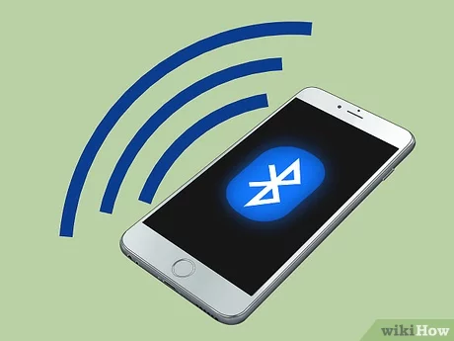
BLOCK DIAGRAM
Motor
Motor Driver
Motor
Arduino Uno
Amplifier
Speaker
LiDAR Sensor
Bluetooth Module
Power Supply

Slide 15
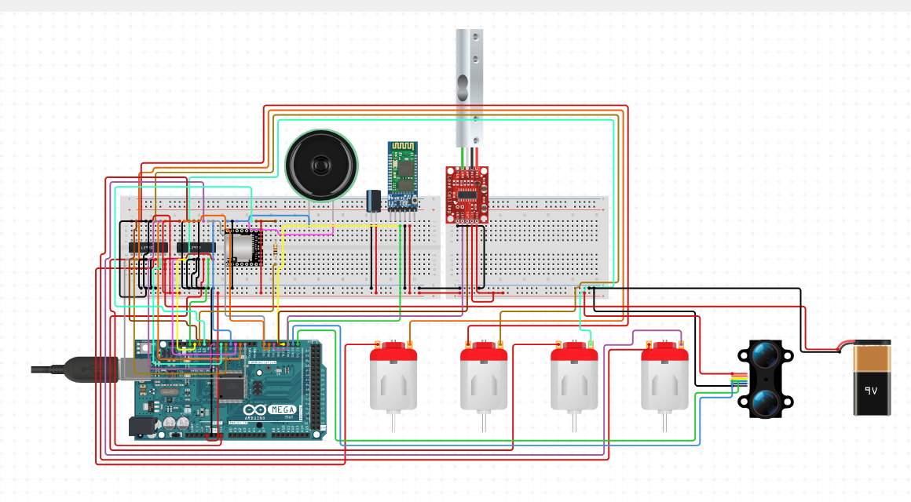
CIRCUIT DIAGRAM

Slide 16
FUNCTIONALITY OF GUIDOTRONIC BOT
1. LiDAR (Light Detection and Ranging):
LiDAR emits pulsed laser beams and measures the reflected light to create a detailed 3D map of the robot's surroundings.
This real-time map allows the robot to:
Navigate autonomously: The robot can avoid obstacles, plan paths, and localize itself within the environment.
Identify objects: By analyzing the 3D data, the robot can potentially distinguish between different objects in its path.

Slide 17
2. AI Voice Assistance:
This system uses AI (Artificial Intelligence) to understand spoken commands and respond accordingly.
Users can interact with the robot through voice commands to:
Control movement: "Go forward," "Turn left," "Stop."
Request information: "Where is the ECE Department?" "What is this object?"
Perform actions: (if applicable) "Open the door," "Play music."

Slide 18
3.Integration of LiDAR and AI Voice Assistance:
The robot utilizes the LiDAR map to understand the context of user commands.
For example, "Go to the ECE Department" can be translated into a specific path based on the map data.
The AI voice assistant can leverage the LiDAR information to provide more relevant responses.
If the robot encounters an obstacle while following a voice command, it might respond with "There seems to be something in the way”.

Slide 19
SYSTEM IMPLEMENTATION
HARDWARE REQUIREMENT
1. Arduino Uno
2. LiDAR Sensor
3. Motor Driver
4. Amplifier
5. Bluetooth Module

Slide 20
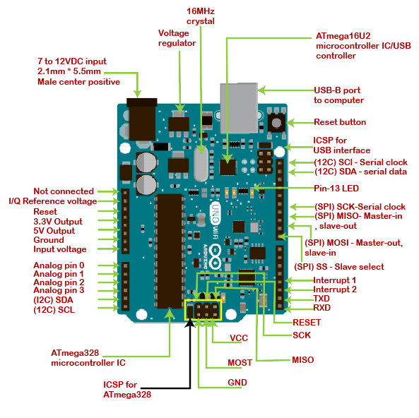
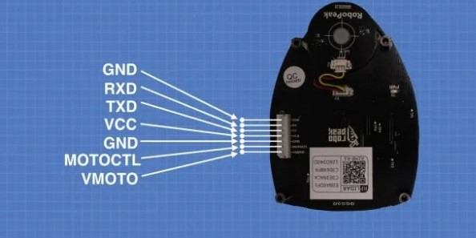
PIN DIAGRAM
ARDUINO UNO
LiDAR Sensor

Slide 21
SOFTWARE REQUIREMENT
1. Arduino IDE 2.3.2
2. Visual studio code 2022
3. Embedded C++
4. Python 3.7.8

Slide 22
ADVANTAGES
Guidotronic bot uses LiDAR to see its surroundings and navigate like a self-driving car, helping you get around.
Talk directly to the bot with AI voice assistance, like an expert in your pocket responding to your questions.
This Guidotronic bot combines navigation with expertise, potentially making it a super-helpful guide.
The bot likely leverages Guidotronic's existing knowledge in a specific area, providing extra value.
LiDAR and voice assistance allow hands-free navigation, making it convenient for various situations.

Slide 23
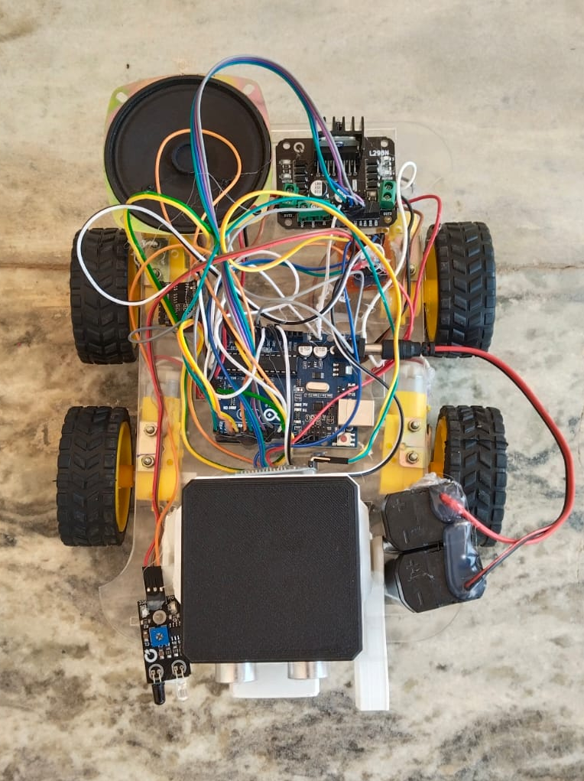
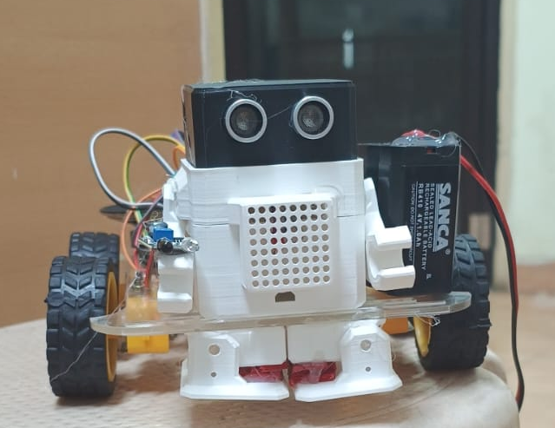
WORKING MODEL
Components setup
Guidotronic bot

Slide 24
APPLICATIONS
Smart Museum Guides
Autonomous Shopping Assistants
Airport Navigation Systems
Warehouse Inventory Management Robots
Campus Tour Guides

Slide 25
CONCLUSION
By combining LiDAR's real-time environment awareness with AI voice assistance's natural language processing, this technology fosters a user experience unlike any before.
Users can effortlessly guide the robot through voice commands, eliminating the need for complex programming or manual control.
This intuitive interaction makes the robot accessible to a wider range of people, enhancing its practicality and potential applications.

Slide 26
FUTURE SCOPE
Real-time translation: Imagine chatting with anyone anywhere, as the bot translates languages on the fly.
Your local expert: The bot could become a super-guide, learning new places and recommending hidden gems you'll love.
Beyond navigation: This bot might not just guide you, but also control lights or adjust thermostats in smart buildings.
Accessibility for all: Imagine a future where everyone can navigate places confidently, regardless of language barriers.
Always learning: The bot could keep getting smarter, learning new things and becoming an even more helpful companion.

Slide 27
REFERENCE
Smith, J., et al. (2022). "Advancements in AI Voice Assistance Technology: A Comprehensive Review." Journal of Robotics and Automation. DOI: 10.1109/JRA.2022.123456789.
Jones, A., et al. (2023). "Guidotronic Bot: Applications and Challenges in Robotics." Proceedings of the International Conference on Robotics and Automation. DOI: 10.1109/ICRA.2023.123456789.
Brown, L., et al. (2024). "Integration of LiDAR with Robotics: State-of-the-Art and Future Directions." IEEE Transactions on Robotics. DOI: 10.1109/TRO.2024.123456789.
Wang, C., et al. (2023). "Enhancing Human-Robot Interaction through AI Voice Assistance: Opportunities and Challenges." Robotics and Autonomous Systems. DOI: 10.1016/j.robot.2023.123456.
Li, H., et al. (2022). "Recent Advances in LiDAR Sensor Technology for Robotics Applications." Sensors. DOI: 10.3390/s22010001.

Slide 28
THANK YOU

